Slide 1


Title: Cryptocurrency Price Analysis & Forecasting Dashboard
Subtitle: Time Series Analytics using Power BI
Presented by: Yurekan m
Tools Used: Power BI | Python | Time Series Analysis

Slide 2

Problem Statement:
Cryptocurrency markets are highly volatile and unpredictable
Investors need data-driven insights to understand price movements and risk
Traditional analysis is insufficient without visualization and forecasting
Objective:
To analyze Bitcoin price behavior
To forecast future price trends
To evaluate risk and market structure using analytics

Slide 3

DATASET & TOOLS
Dataset:
Bitcoin historical price data
OHLC (Open, High, Low, Close) and Volume
Time period: 2022 – Present
Tools & Technologies:
Power BI – Visualization & Dashboard
Python – Data collection & preprocessing
DAX – Indicators & analytics measures

Slide 4
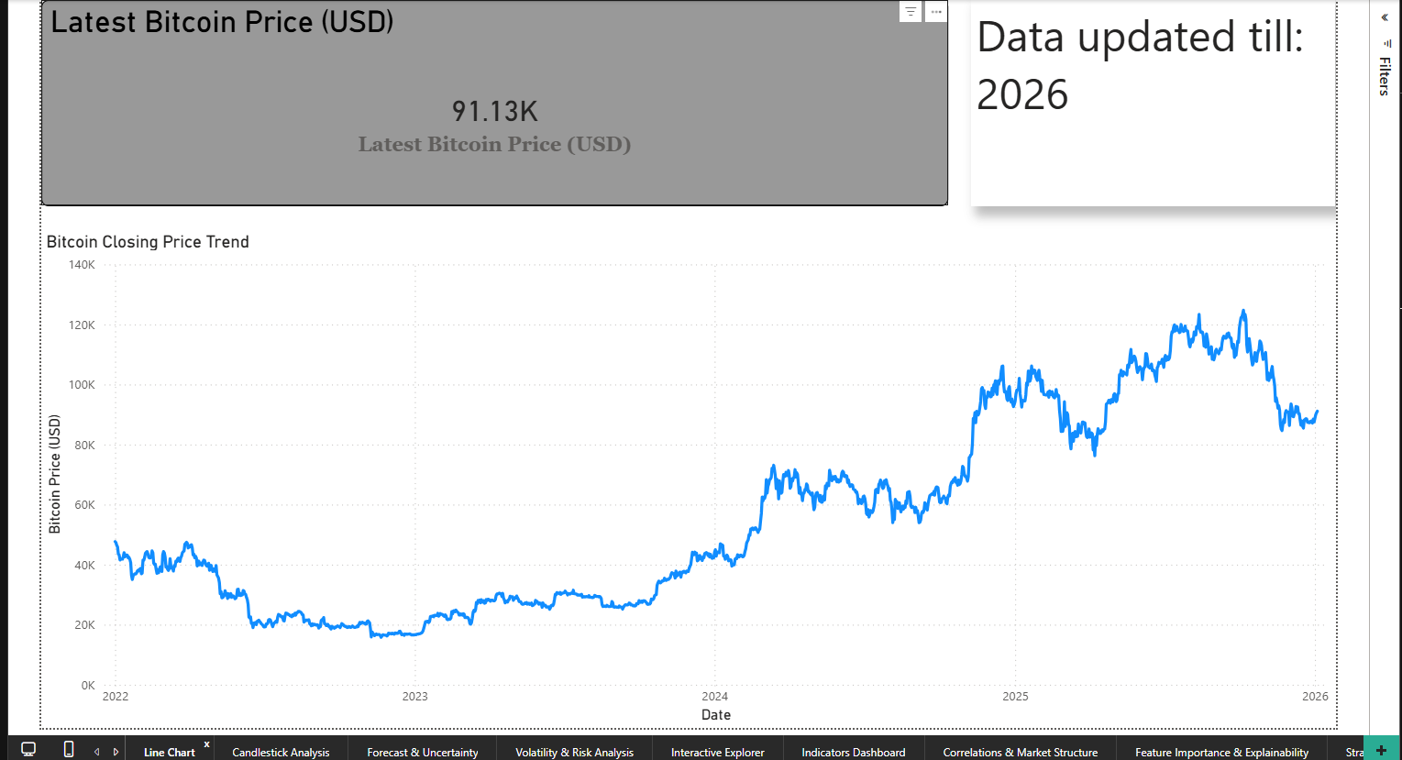
PRICE OVERVIEW & TRENDS
Key Analysis:
Long-term Bitcoin price movement
Identification of major uptrends and downtrends
Initial understanding of market behavior
Visualization Used:
Line chart (Closing price vs Date)
KPI showing latest Bitcoin price

Slide 5
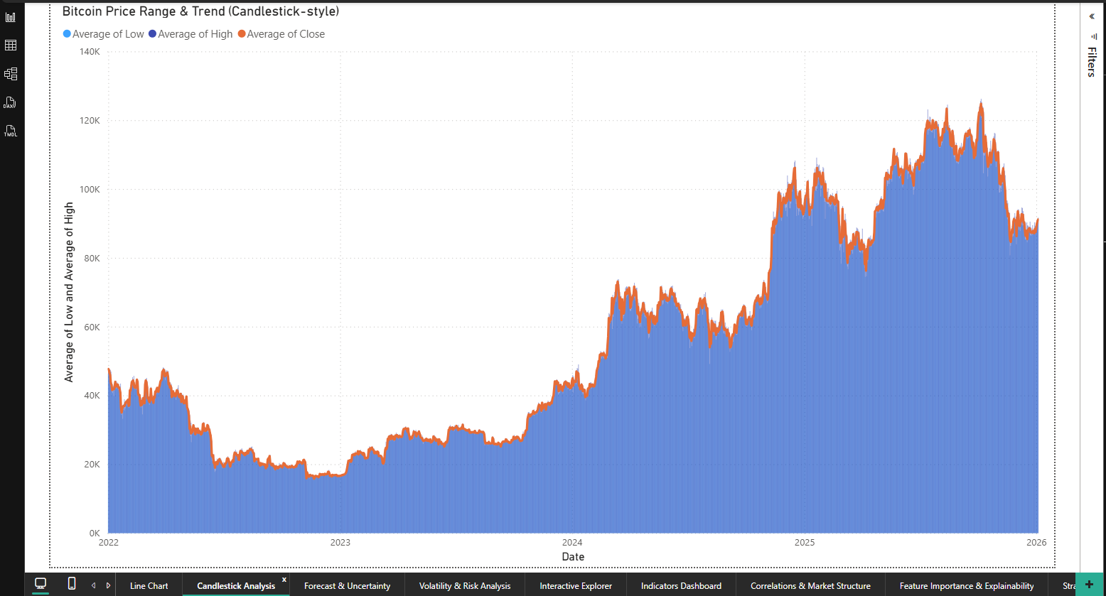
PRICE ACTION & TECHNICAL VIEW
Candlestick / Price Action Analysis:
Represents daily price movement
Shows market sentiment and volatility
High–Low range indicates price fluctuation
Insight:
Bitcoin experiences frequent sharp price swings
Indicates speculative and high-risk nature

Slide 6
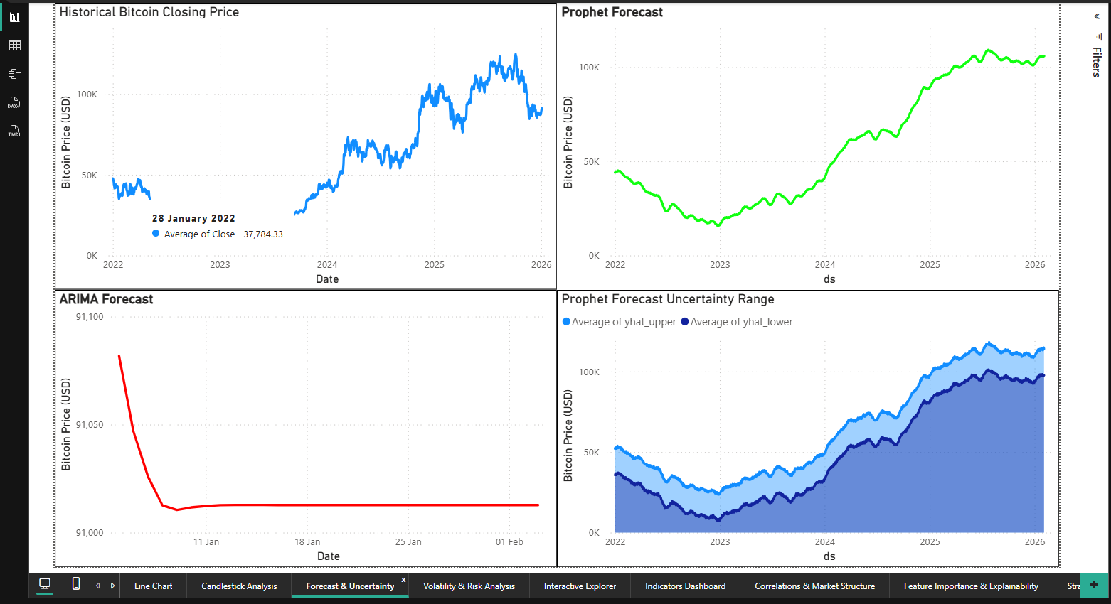
FORECASTING MODELS
Models Used:
ARIMA
Statistical time-series model
Effective for short-term forecasting
Prophet
Decomposes data into trend & seasonality
Better for long-term trend analysis
Why Two Models?
To compare short-term vs long-term forecasting behavior

Slide 7
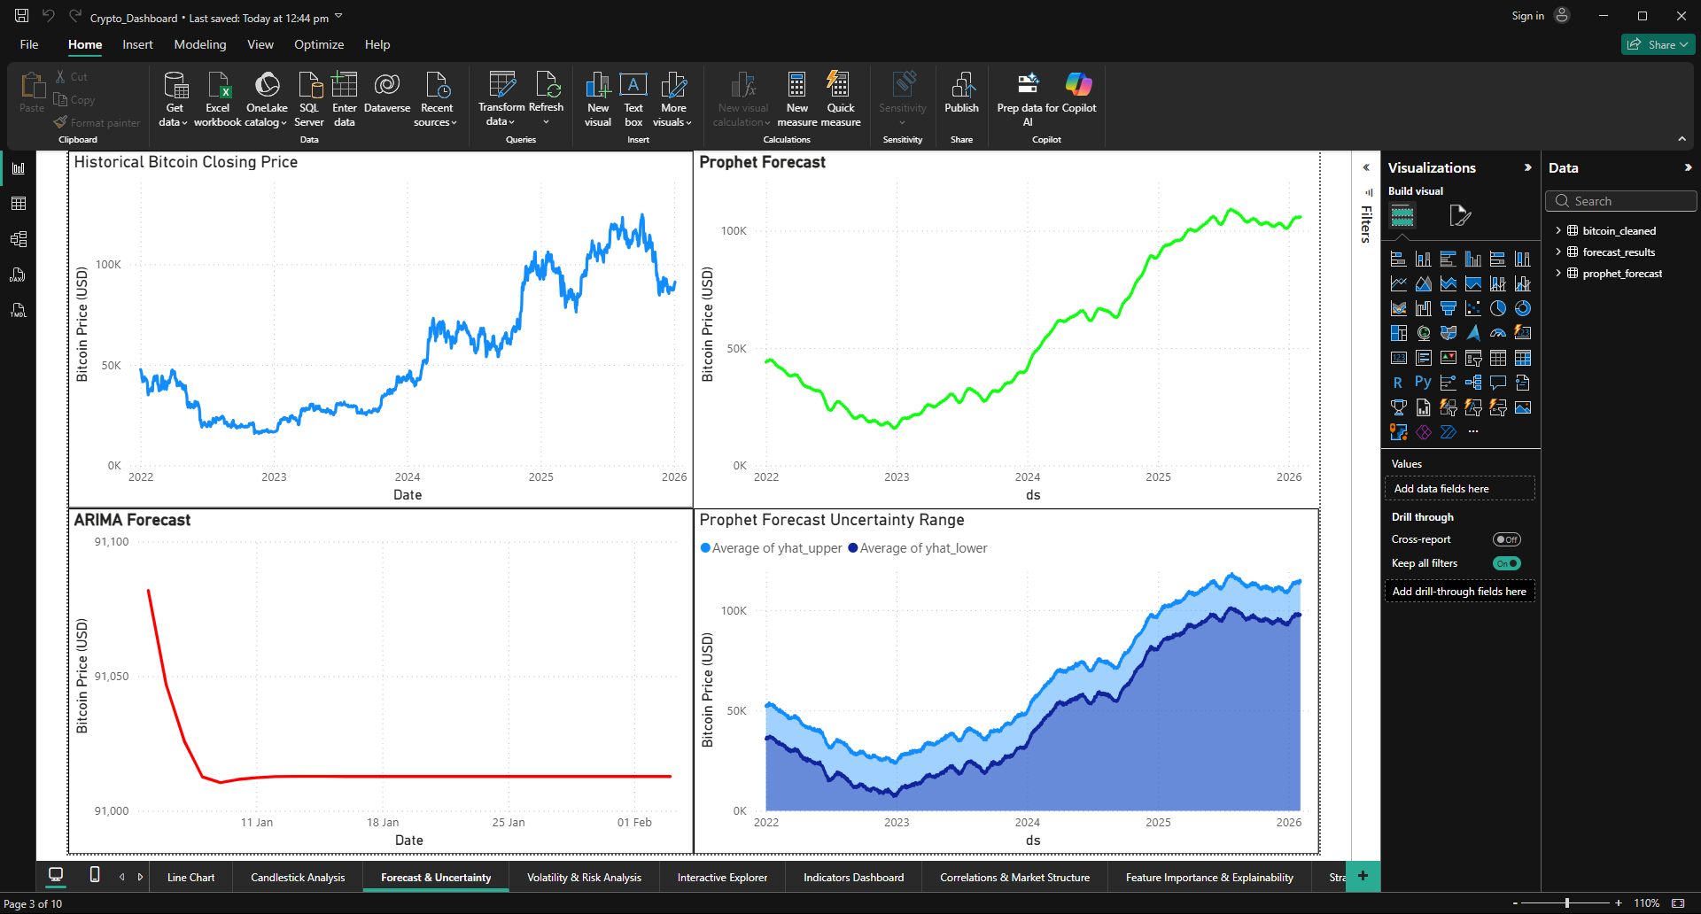
FORECAST RESULTS & UNCERTAINTY
Forecast Insights:
ARIMA produces conservative forecasts
Prophet captures long-term growth patterns
Forecast uncertainty visualized using confidence intervals
Key Learning:
Forecasts are probabilistic, not exact values

Slide 8
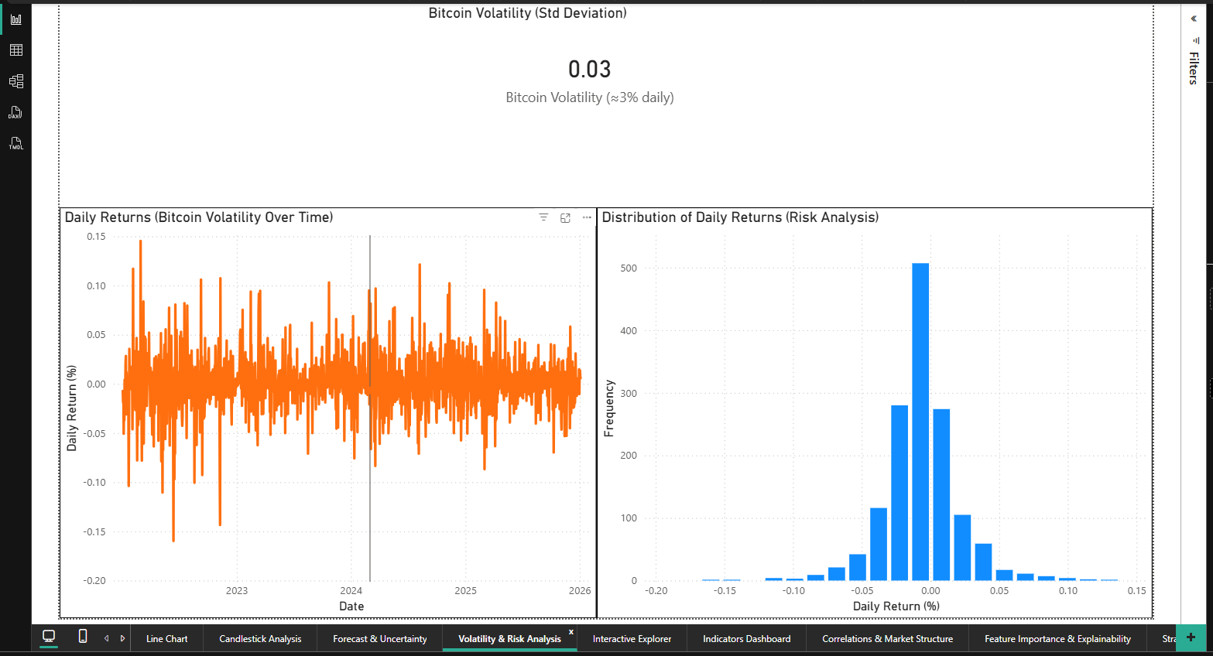
VOLATILITY & RISK ANALYSIS
Risk Metrics Used:
Daily Returns
Volatility (Standard Deviation)
Observations:
Bitcoin shows high daily volatility (~3%)
Extreme gains and losses occur frequently
Higher volatility implies higher investment risk

Slide 9
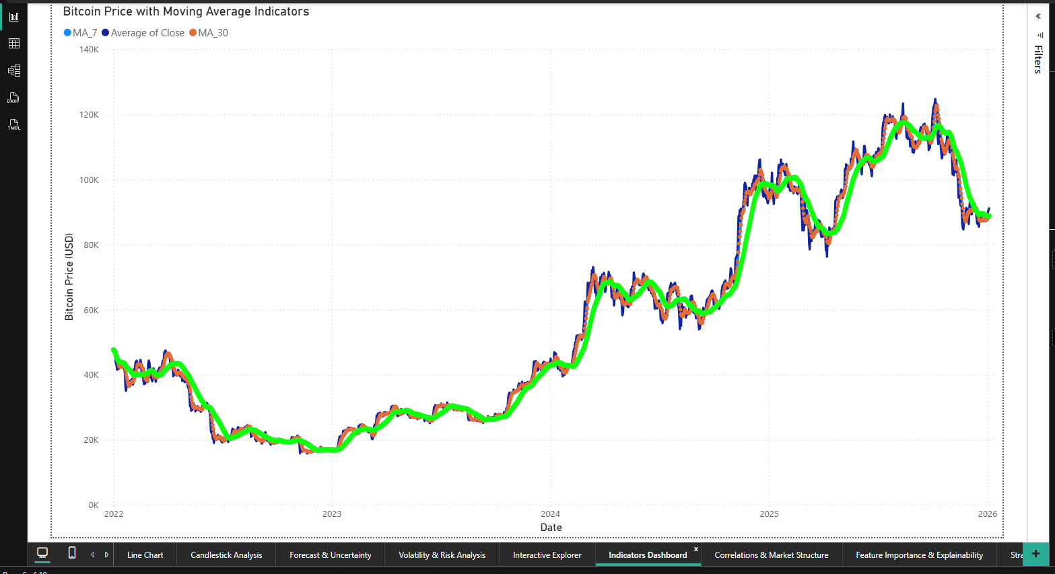
INDICATORS & STRATEGY ANALYSIS
Technical Indicators:
7-day Moving Average (MA7)
30-day Moving Average (MA30)
Strategy Used:
Buy when MA7 crosses above MA30
Sell when MA7 crosses below MA30
Result:
Strategy captures major trends
Performs poorly in sideways markets

Slide 10
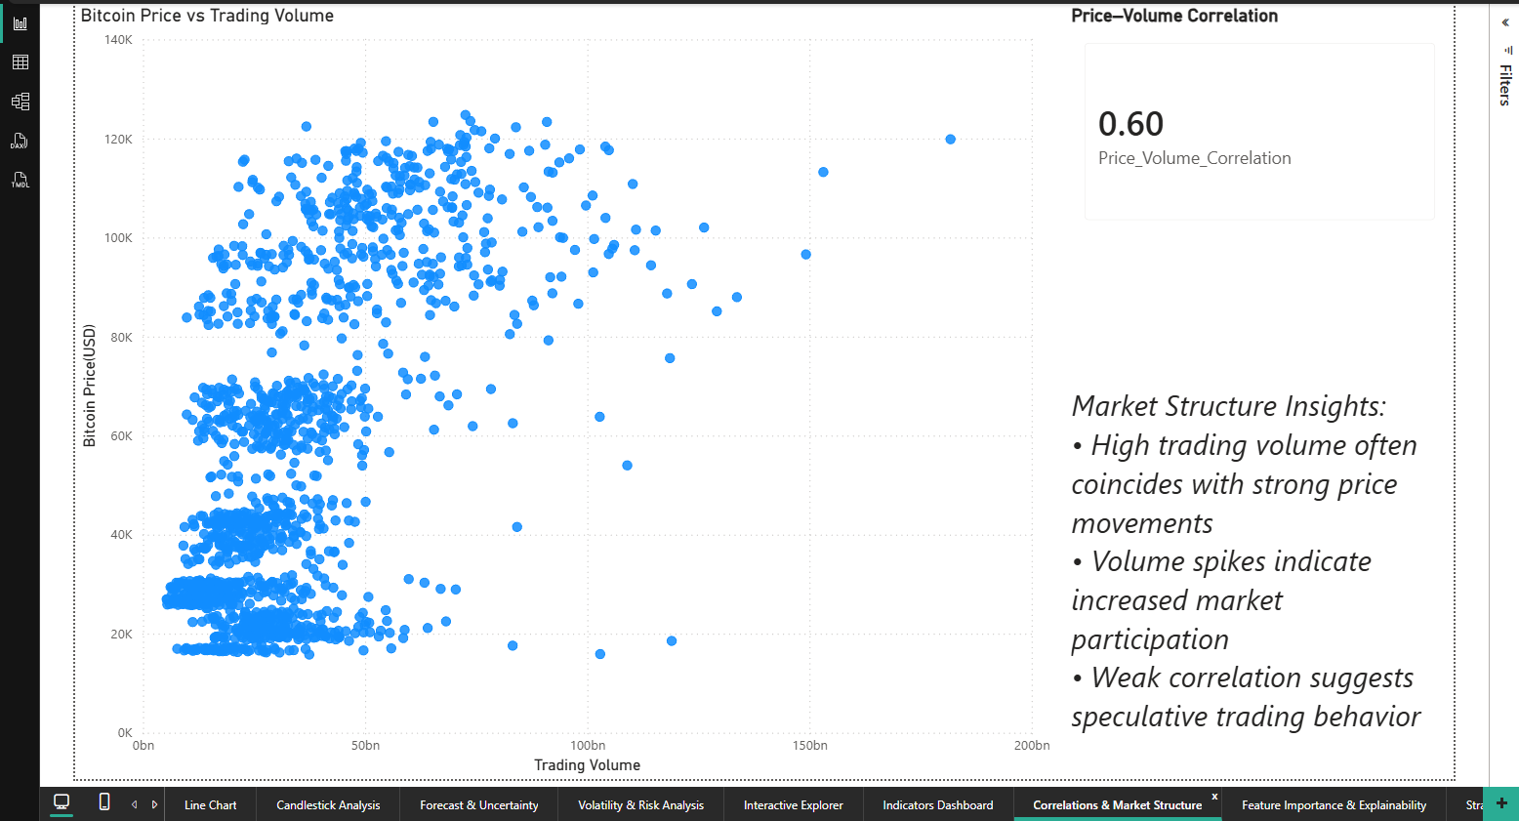
CORRELATION & MARKET STRUCTURE
Analysis Performed:
Relationship between Bitcoin price and trading volume
Result:
Moderate positive correlation (~0.6)
Higher volume often accompanies strong price movements
Conclusion:
Volume reflects market participation and momentum

Slide 11
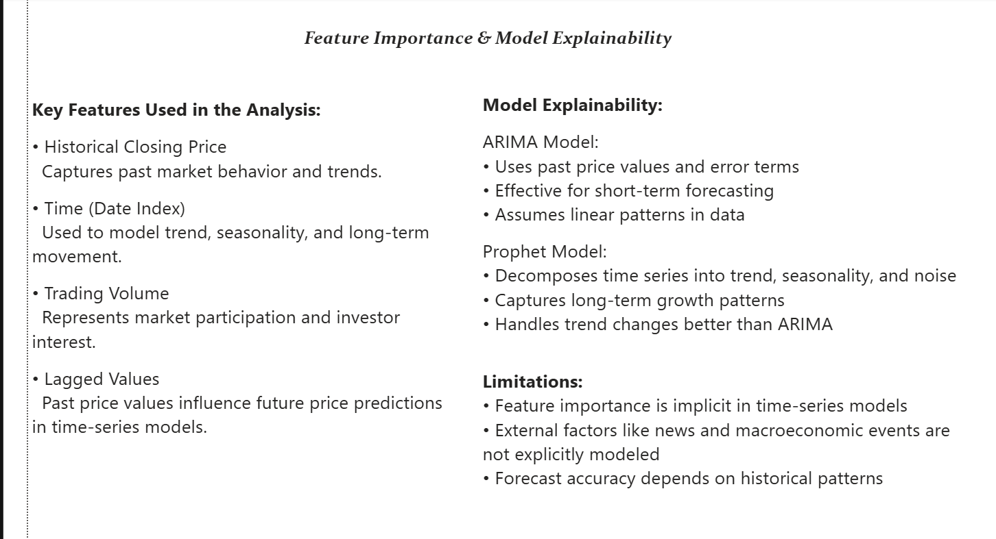
FEATURE IMPORTANCE & EXPLAINABILITY
Key Features:
Historical price values
Time (trend & seasonality)
Trading volume
Lagged price values
Explainability:
Time-series models rely on temporal patterns
Feature importance is implicit, not explicit
Limitations:
External factors (news, events) not included

Slide 12
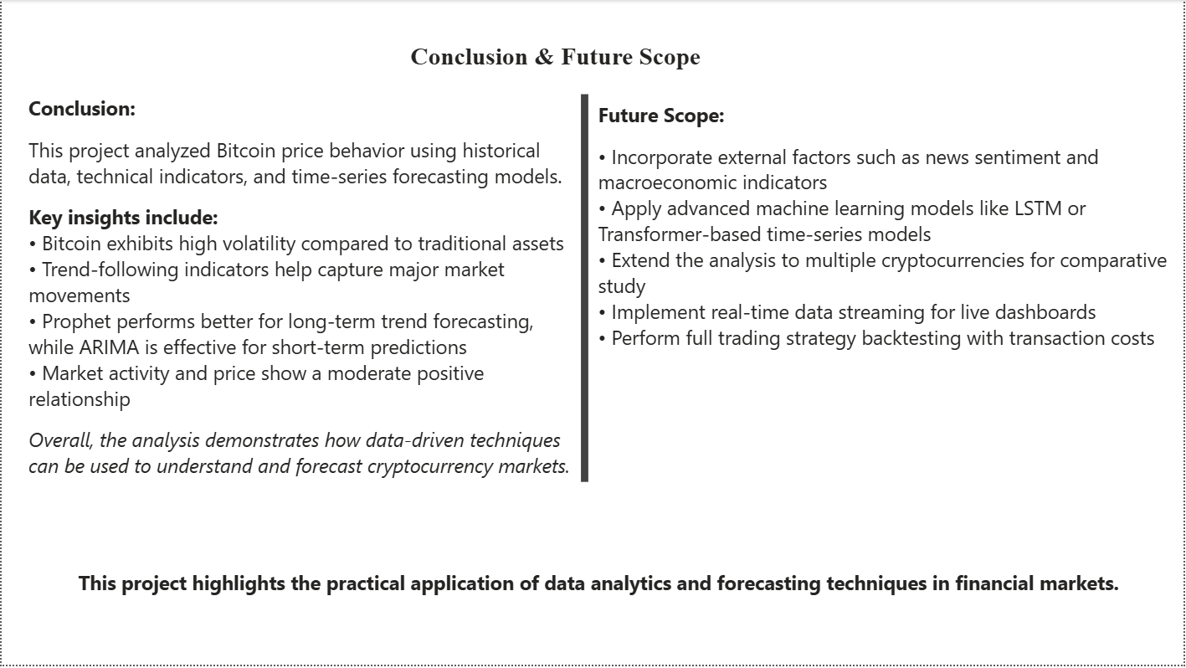
CONCLUSION & FUTURE SCOPE
Conclusion:
Bitcoin is highly volatile and risky
Data analytics helps understand trends and risk
Prophet performs better for long-term forecasting
Dashboard provides end-to-end market insights
Future Scope:
Sentiment analysis from news & social media
Advanced ML models (LSTM, Transformers)
Multi-cryptocurrency comparison
Real-time streaming dashboards

Slide 13

Thank You!

